Slide 1
visualization
Soumya banerjee

Slide 2

unSupervised learning

Slide 3
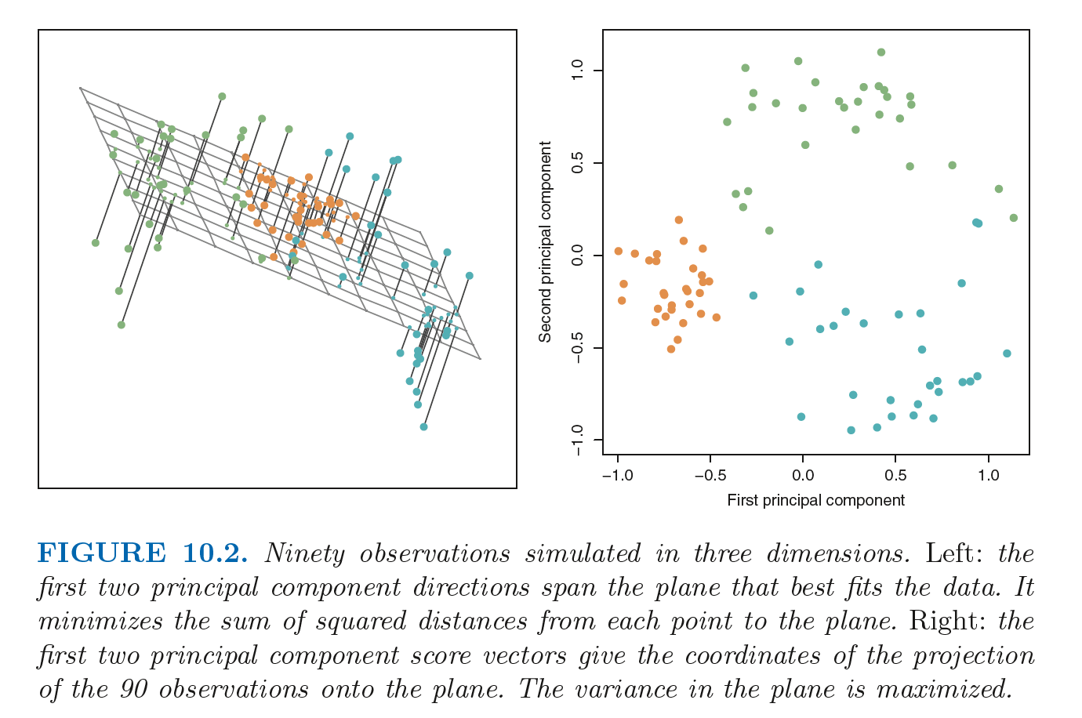
unSupervised learning

Slide 4
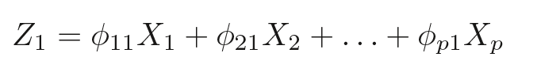
unSupervised learning

Slide 5
Basics and pitfalls in data visualization (TUFTE) 1. Less is more. “Above all else show the data” (p. 92). 2. “Graphical excellence consists of complex ideas communicated with clarity, precision, and efficiency.” (p. 51) 3. Keep it proportional! “Lie Factor = size of effect shown in graphic divided by size of effect in data” (p.57). Keep it close to 1. 4.You don’t have to use a graphic when there isn’t much data — a table is often better. 5. Pie charts are useless.
Principles of data visualization (tufte)
https://jeffhale.medium.com/five-takeaways-from-the-visual-display-of-quantitative-information-dd36dae35299
Notes:
Example of IL10 project (tSNE and heatmaps from a bioinformatics project)

Slide 6
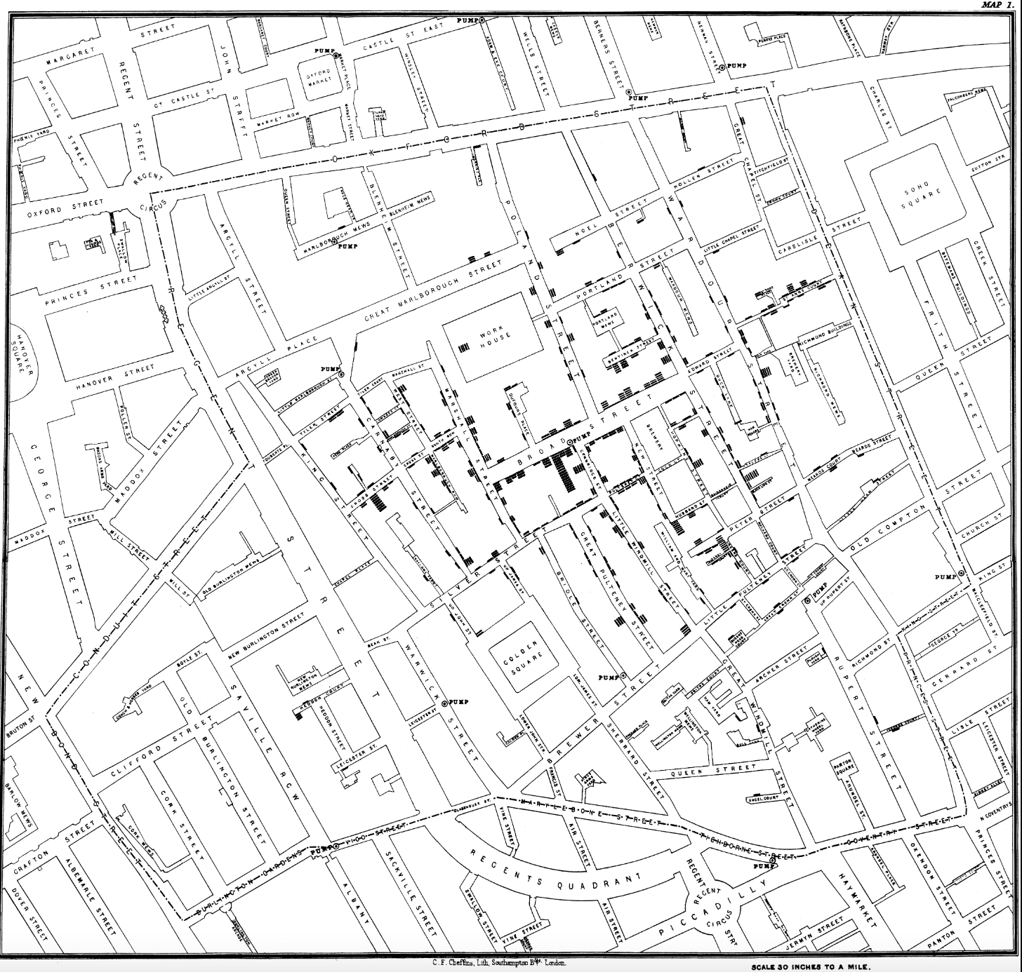
Basics and pitfalls in data visualization 1. Tufte 2. Less is more. “Above all else show the data” (p. 92). Erase everything you don’t need. “Graphical excellence consists of complex ideas communicated with clarity, precision, and efficiency.” (p. 51) Keep it proportional! “Lie Factor = size of effect shown in graphic divided by size of effect in data” (p.57). Keep it close to 1. You don’t have to use a graphic when there isn’t much data — a table is often better. Pie charts are useless. The dude hates pie charts.
Principles of data visualization (tufte)
Notes:
Example of IL10 project (tSNE and heatmaps from a bioinformatics project)

Slide 7
1. https://pudding.cool/projects/heat-records-map/ 2. https://pudding.cool/2022/12/yard-sale/ power law distributions
Principles of data visualization (tufte)
Notes:
Example of IL10 project (tSNE and heatmaps from a bioinformatics project)

Slide 8
Heatmaps tSNE communicate data storytelling distances not preserved stochastic difficult to communicate to non-technical experts
Principles of data visualization
Notes:
Example of IL10 project (tSNE and heatmaps from a bioinformatics project)

Slide 9
Michale gastner visualization
Principles of data visualization
Notes:
Example of IL10 project (tSNE and heatmaps from a bioinformatics project)

Slide 10
problems with communicating high dimensional data. High dimensions are difficult to visualize maps 3d to 2d
Visualizing high-dimensions
Notes:
Example of IL10 project (tSNE and heatmaps from a bioinformatics project)

Slide 11
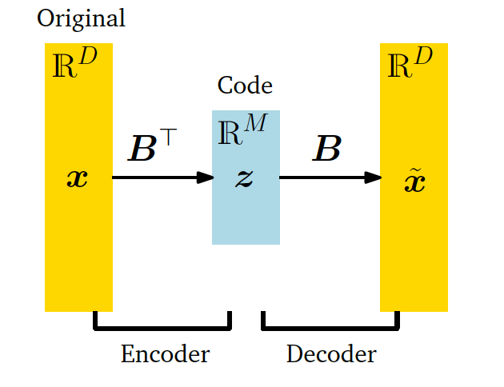
Important concept
Information bottleneck

Slide 12
assumptions
Linearity (linear relationship between data points and lower dimensional representation)
Loss function/reconstruction error (squared loss)
Uses the dot product (one type of inner product)

Slide 13
generalizations of this idea
tSNE
Autoencoder (non-linear loss function)

Slide 14
pitfalls
Distances not preserved
tSNE can be used for hypothesis generation. There are many pitfalls to this.
https://distill.pub/2016/misread-tsne/
Other pitfalls: distances not preserved. For example, a 2d map is a projection from 3D

Slide 15
Case studies
removing outliers in genomic data using PCA.
Frequently in genomic data we may have to remove outliers. These outliers may be due to technical/batch effects or unknown reasons not connected to biology.
This has implications for any tests performed downstream. For example, t-tests can be performed downstream after performing PCA. If there are outliers, it may affect the results of the t-test. See \cite{Aschenbrenner2019} for an application to bulk and single-cell sequencing data.

Slide 16
Case studies
Visualization/dimensionality reduction pitfalls
Pitfalls
https://distill.pub/2016/misread-tsne/
Other pitfalls: distances not preserved. For example, a 2d map is a projection from 3D

Slide 17

Case study
Notes:
Example of IL10 project (tSNE and heatmaps from a bioinformatics project)

Slide 18

Case study
Notes:
Example of IL10 project (tSNE and heatmaps from a bioinformatics project)

Slide 19
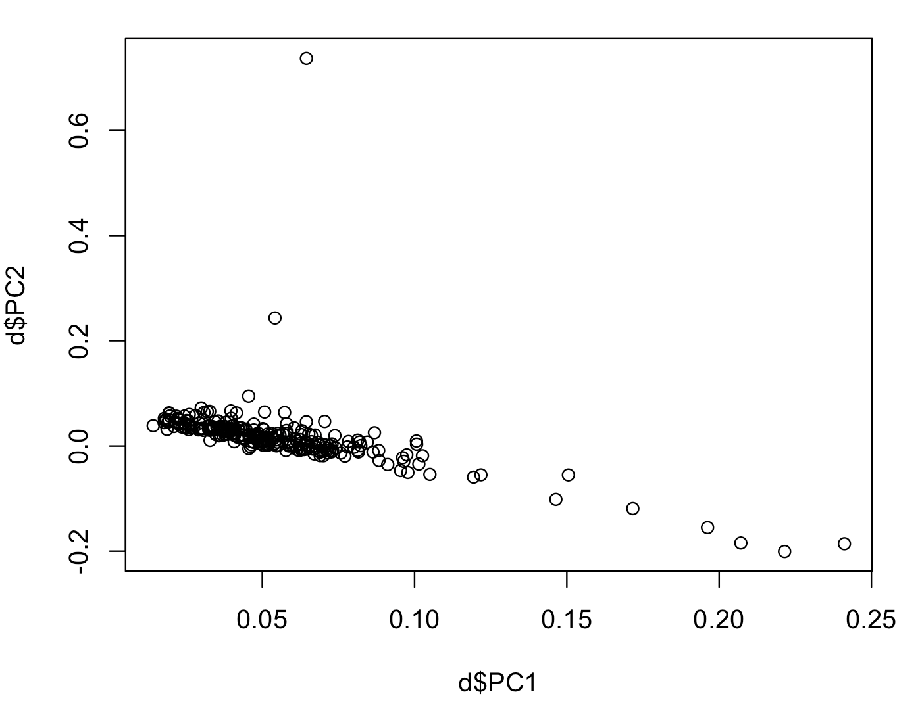
Notes:
Example of IL10 project (tSNE and heatmaps from a bioinformatics project)

Slide 20
T-test
Notes:
Example of IL10 project (tSNE and heatmaps from a bioinformatics project)

Slide 21
Design matrix Glm Correlated periodic Exponential Hiow to pick How do I get to this out of data How do I communicate this to stakeholders More tools for data visualization Generate data Visualize it High dumenosional data Results visualizE Communicate this Cancer woring link winter environmental actiivis Rachel carson silent spring pitfalls prob visualize
Notes:
Example of IL10 project (tSNE and heatmaps from a bioinformatics project)

Slide 22
Basics and pitfalls in data visualization 1. Know your audience 2. Pick visualization based on audience 3. Visualize data and then pick models 4. Add narrative
Notes:
Example of IL10 project (tSNE and heatmaps from a bioinformatics project)

Slide 23
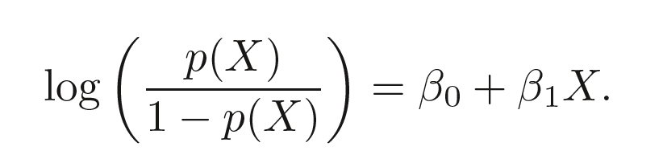
Notes:
Example of IL10 project (tSNE and heatmaps from a bioinformatics project)

Slide 24
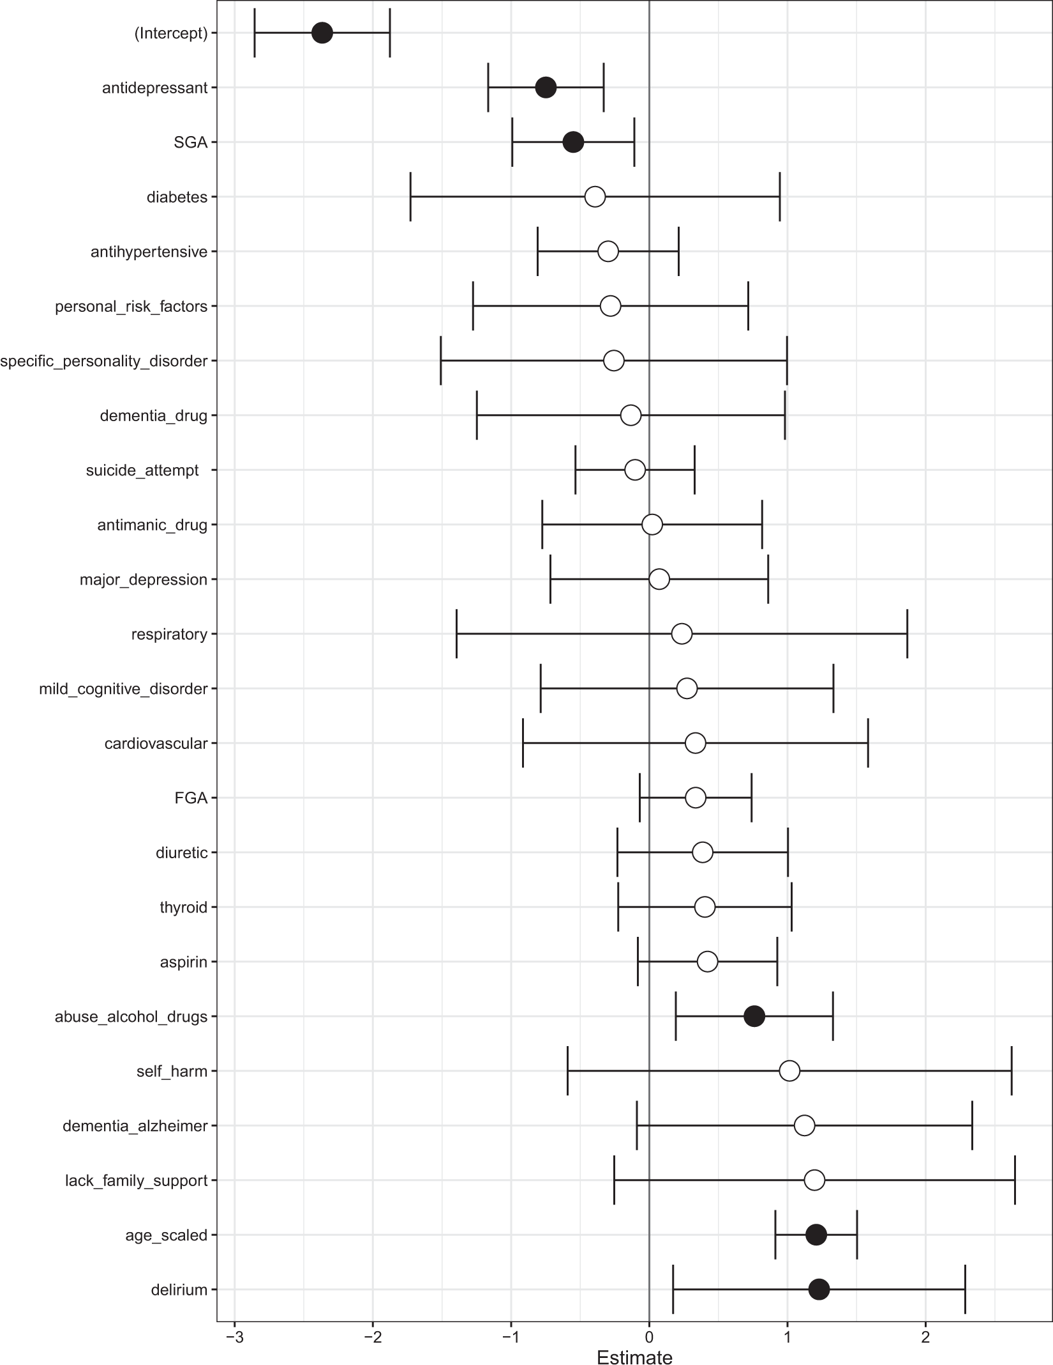
Notes:
Example of IL10 project (tSNE and heatmaps from a bioinformatics project)

Slide 25
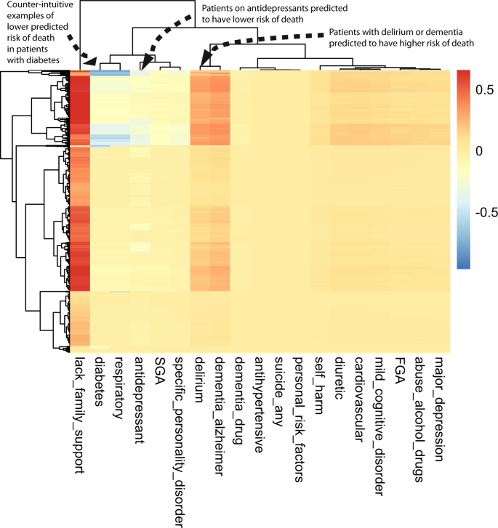
Notes:
Example of IL10 project (tSNE and heatmaps from a bioinformatics project)

Slide 26
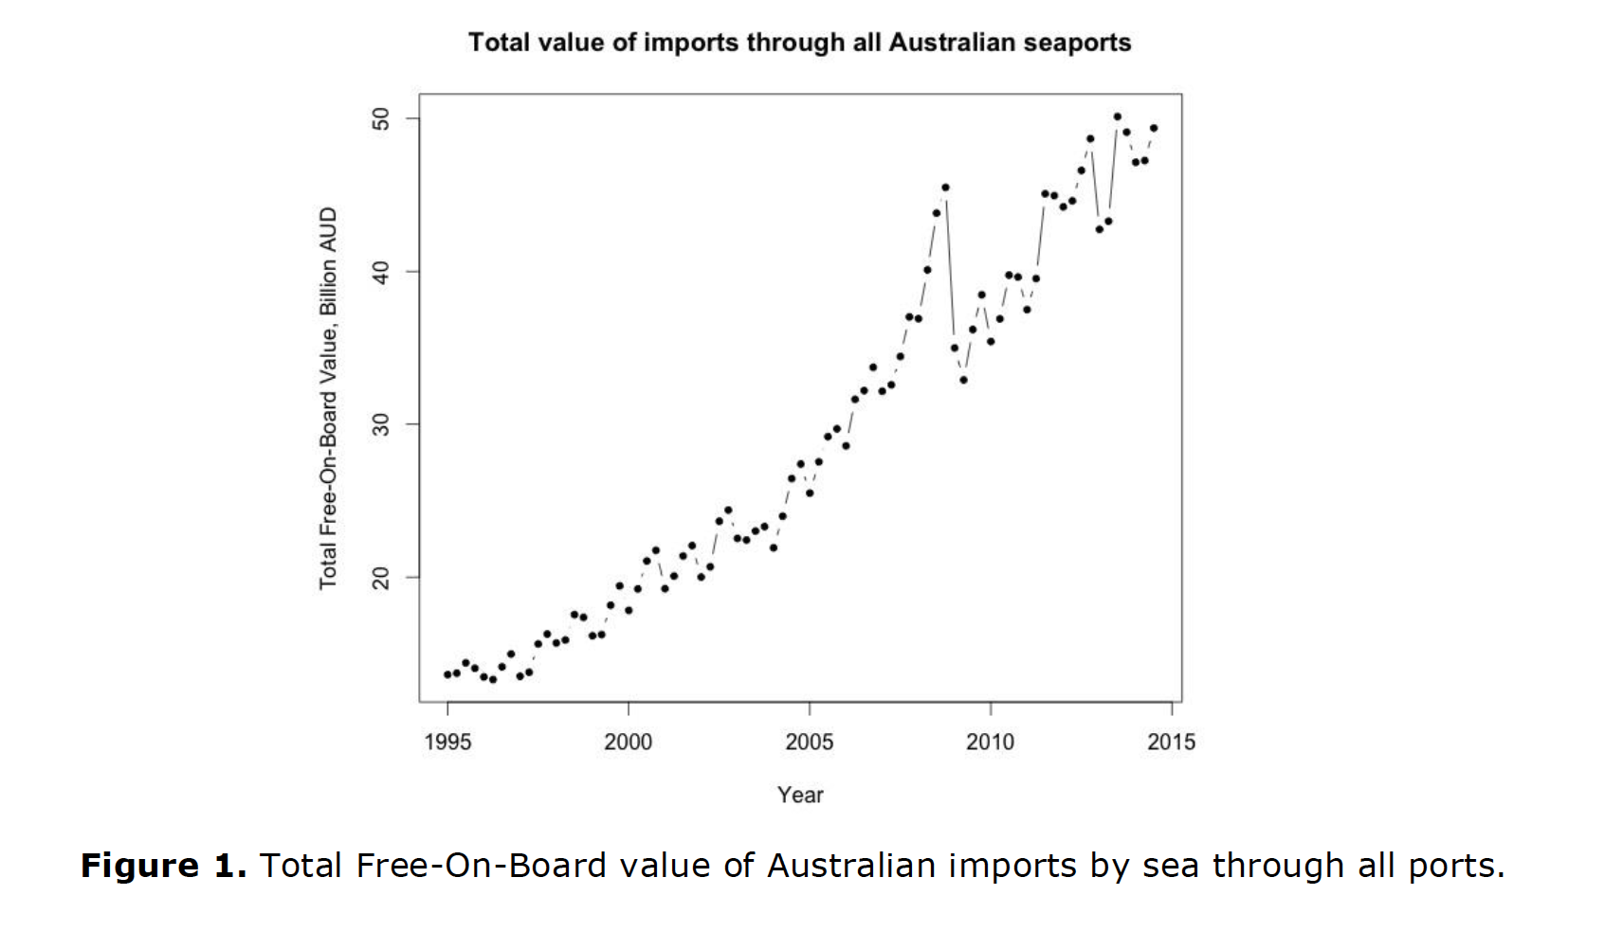
Notes:
Example of IL10 project (tSNE and heatmaps from a bioinformatics project)

Slide 27
Visualizing the data (for example, time-series data) can reveal what kinds of models would be appropriate. For example, if time series data has some seasonality, then a seasonal auto-regressive model (SARIMA) may be appropriate.
Visualization may also reveal if the underlying model/assumptions may have changed after a certain time. For example, in financial time-series data, there usually is a change after 2008 due to the global financial crisis.
This may suggest that a new model or more data is required.
Notes:
Example of IL10 project (tSNE and heatmaps from a bioinformatics project)

Slide 28
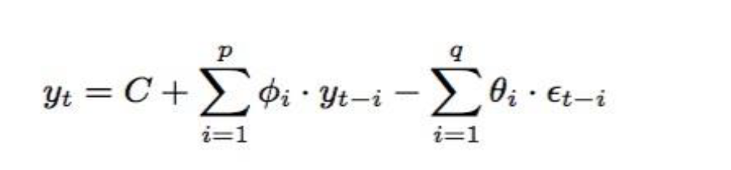
Notes:
Example of IL10 project (tSNE and heatmaps from a bioinformatics project)

Slide 29
Assumptions
Similar to linear regression/GLM (VAR model/ARIMA)
Look at correlations
Simpler models are better (moving averages better than anything fancy/ML)
Notes:
Example of IL10 project (tSNE and heatmaps from a bioinformatics project)

Slide 30
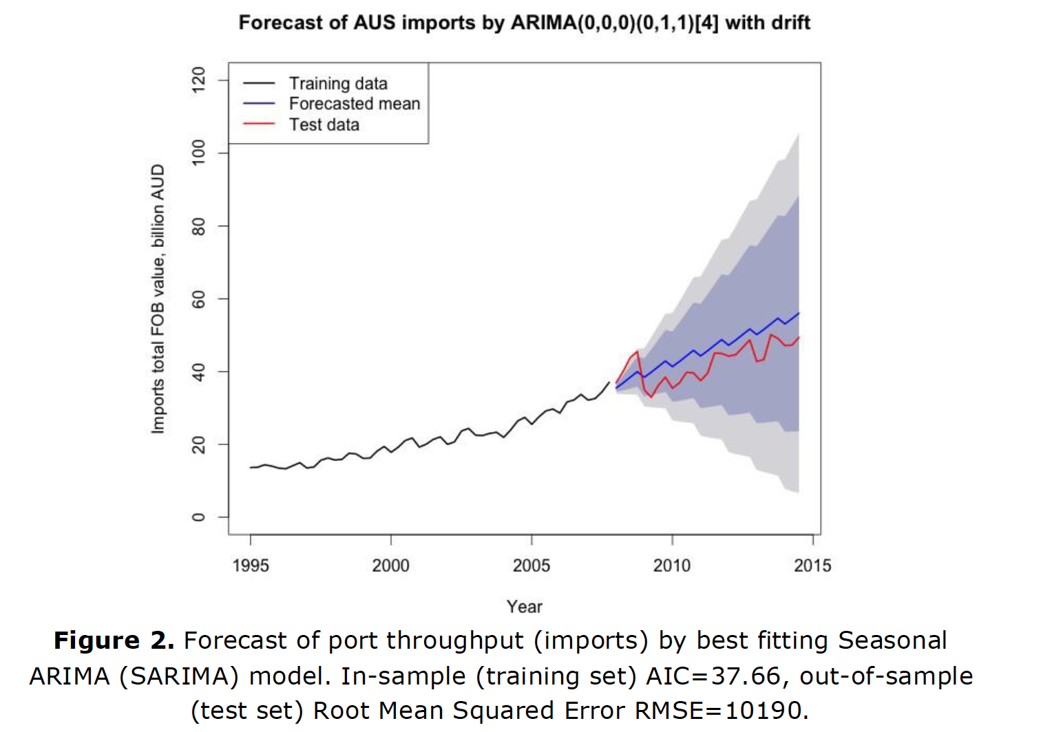
Notes:
Example of IL10 project (tSNE and heatmaps from a bioinformatics project)

Slide 31
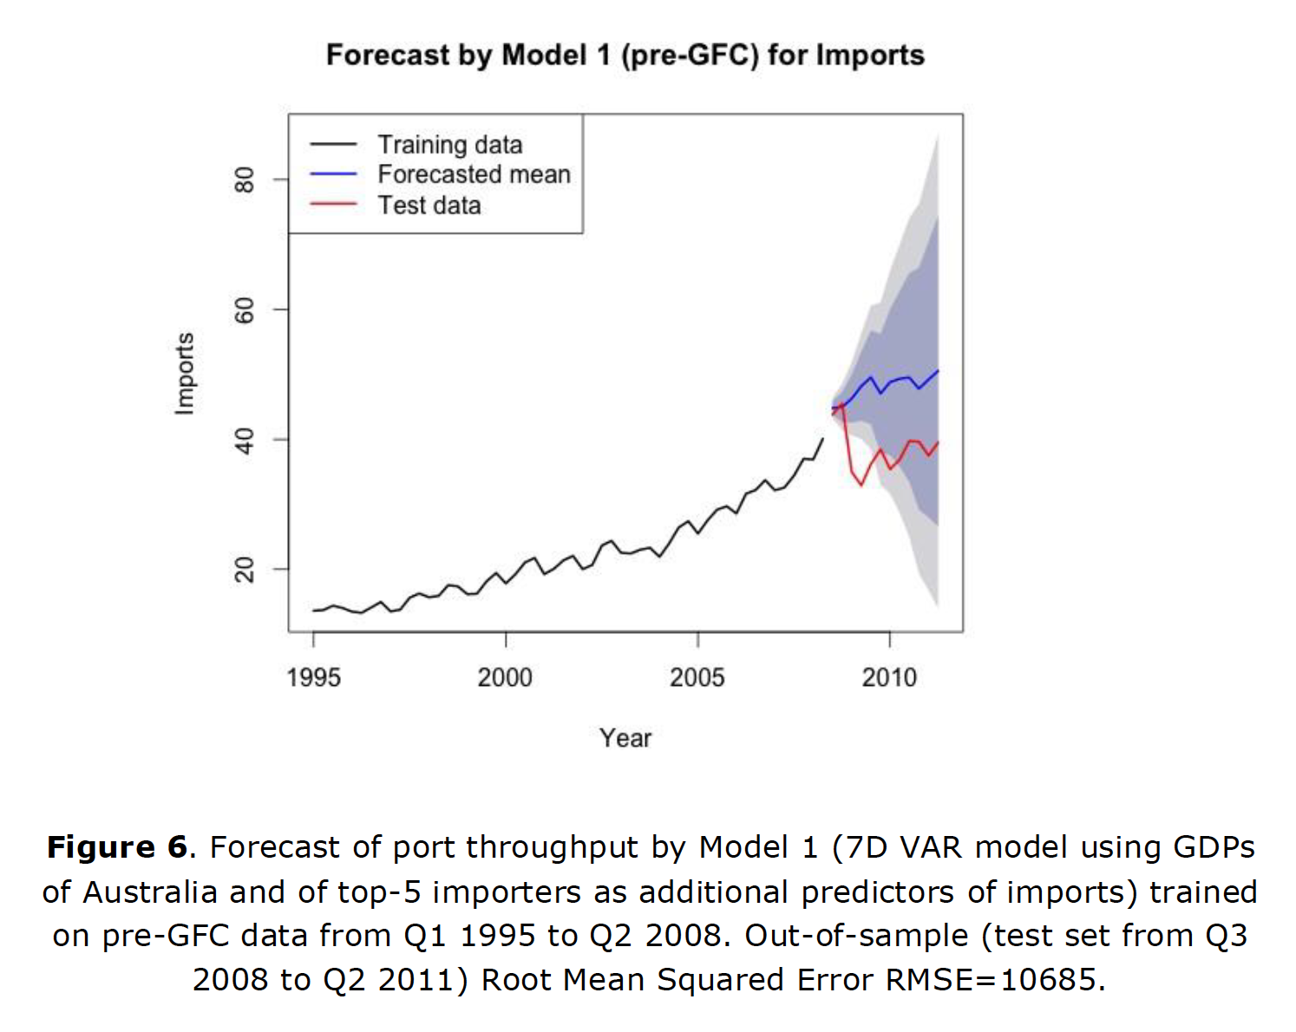
Notes:
Example of IL10 project (tSNE and heatmaps from a bioinformatics project)

Slide 32
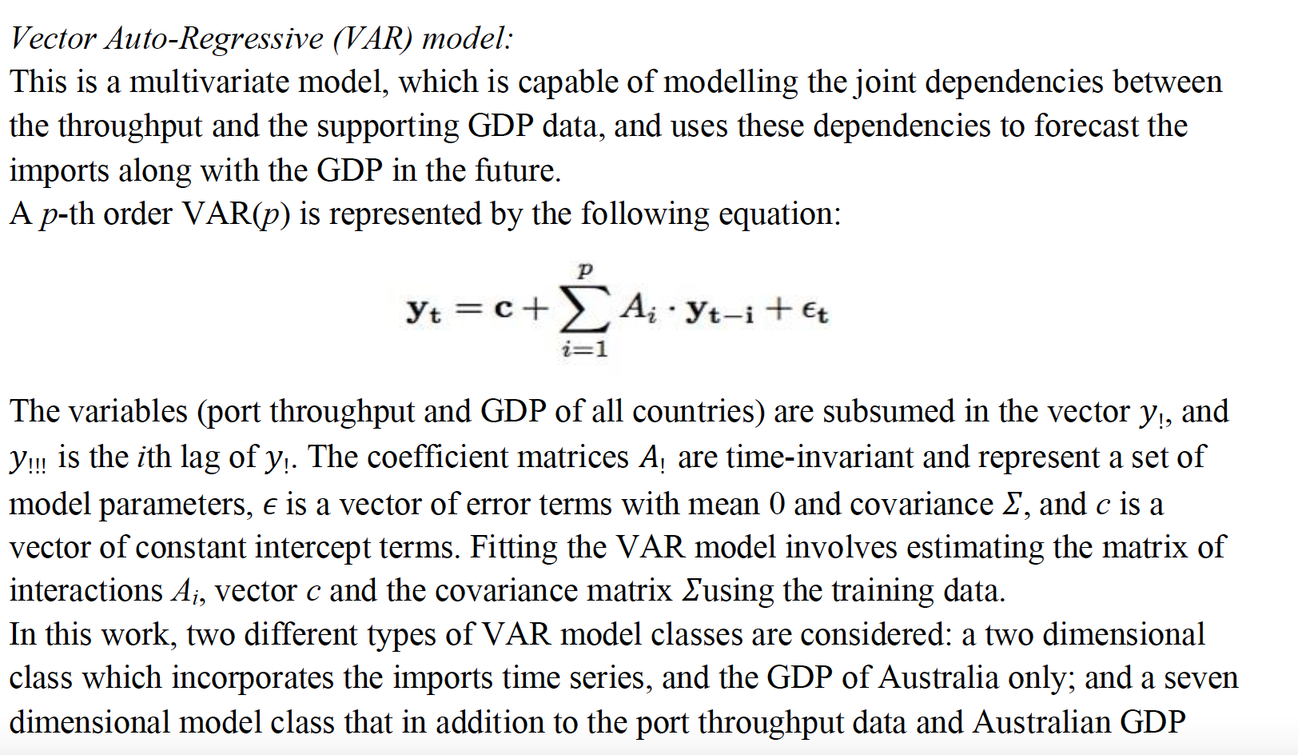
Notes:
Example of IL10 project (tSNE and heatmaps from a bioinformatics project)

Slide 33
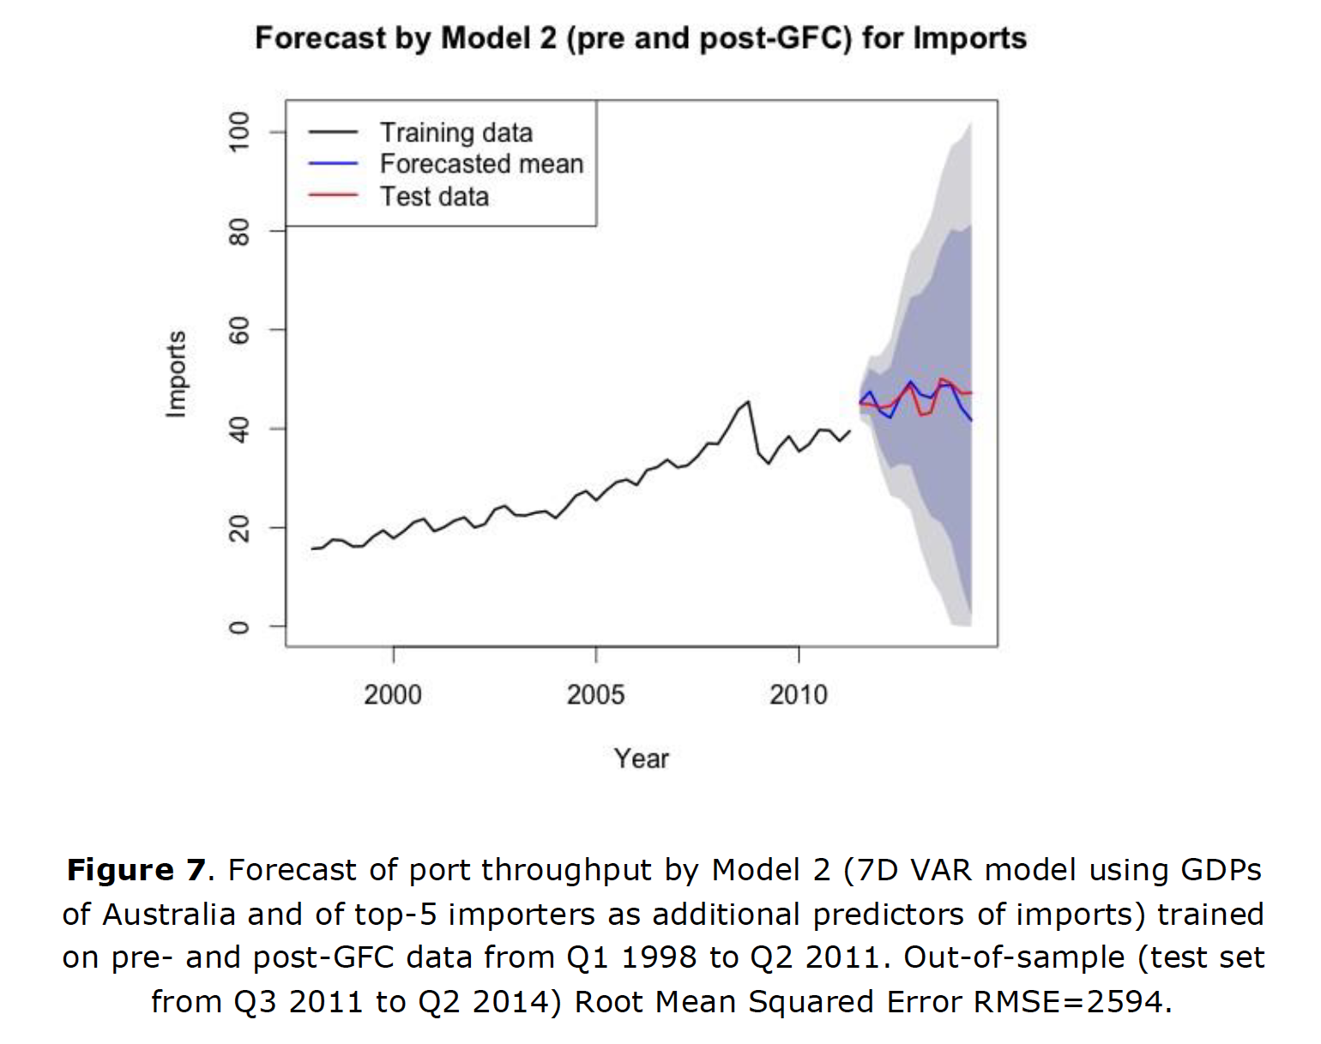
Notes:
Example of IL10 project (tSNE and heatmaps from a bioinformatics project)

Slide 34
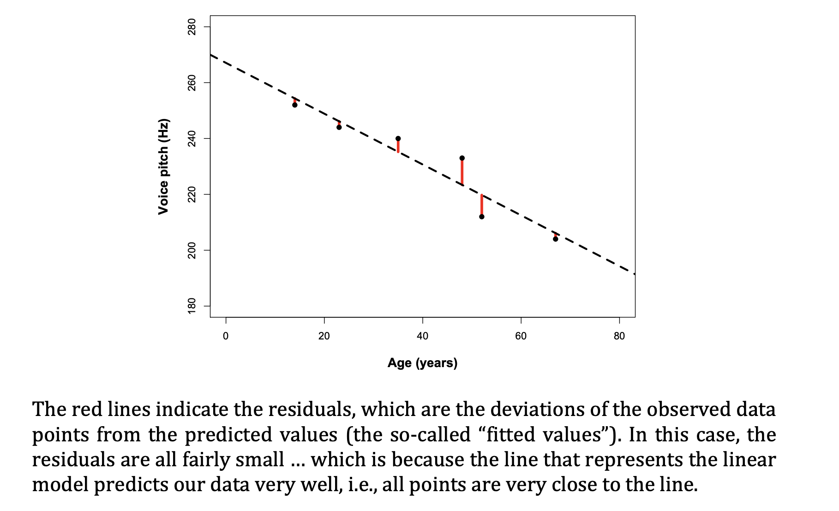
Assumptions: linearity

Slide 35
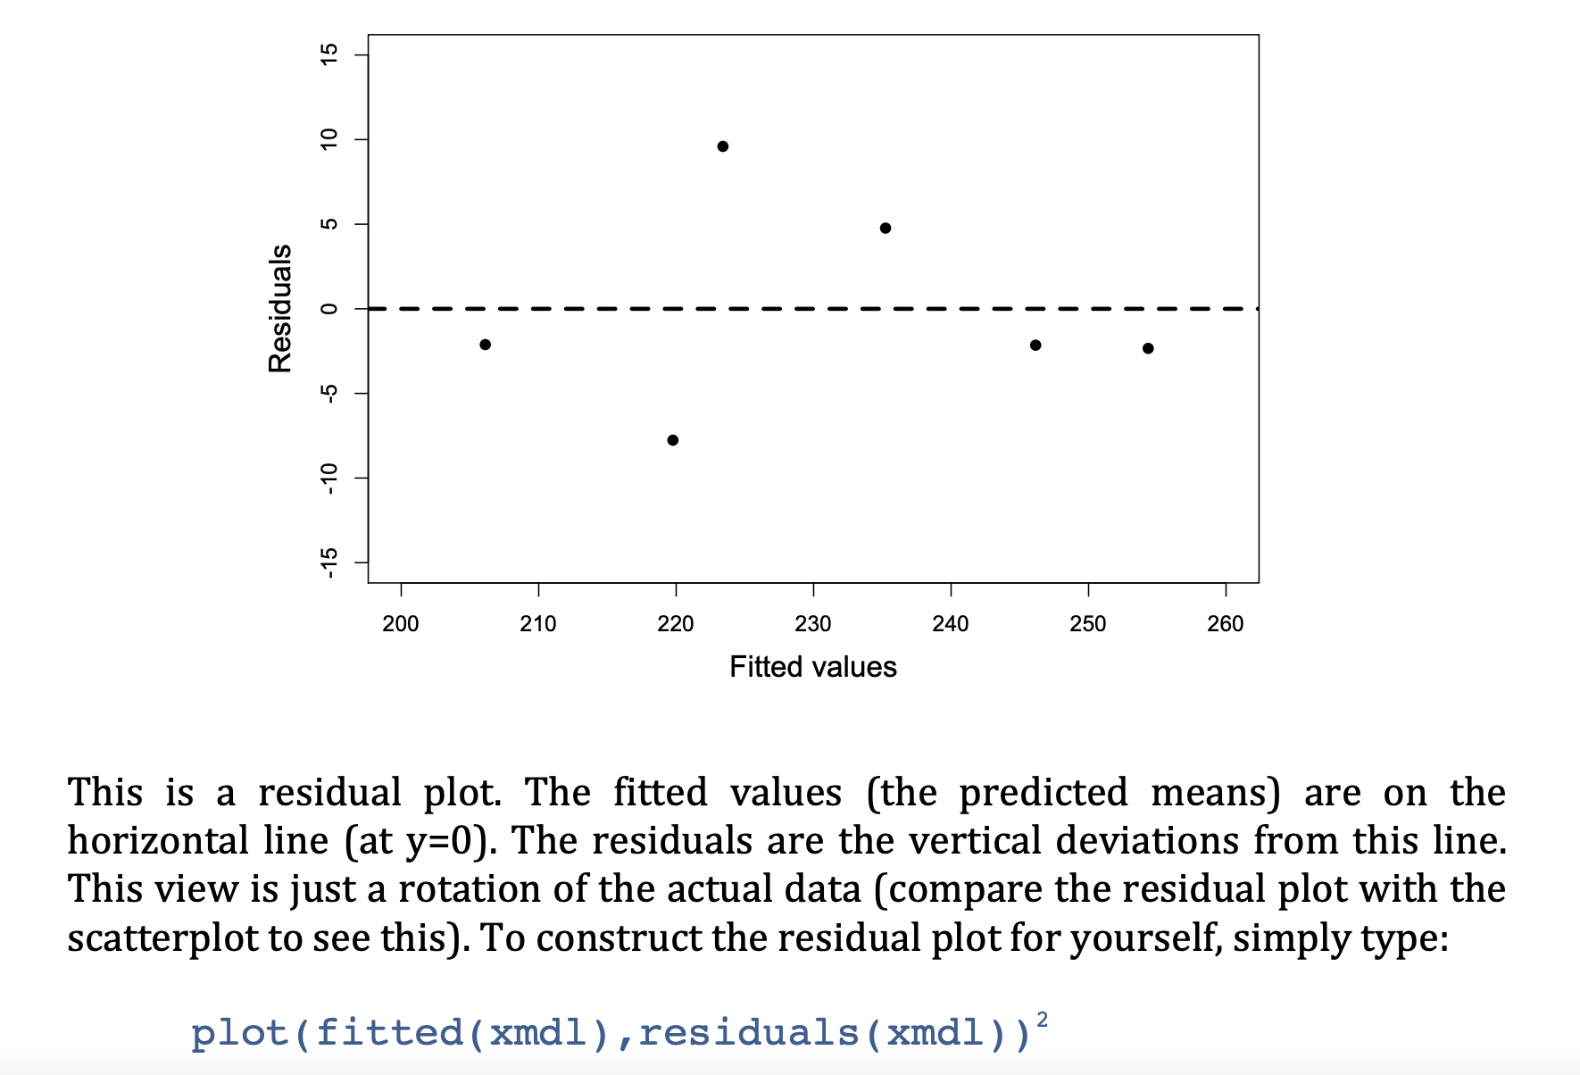
Assumptions: linearity

Slide 36
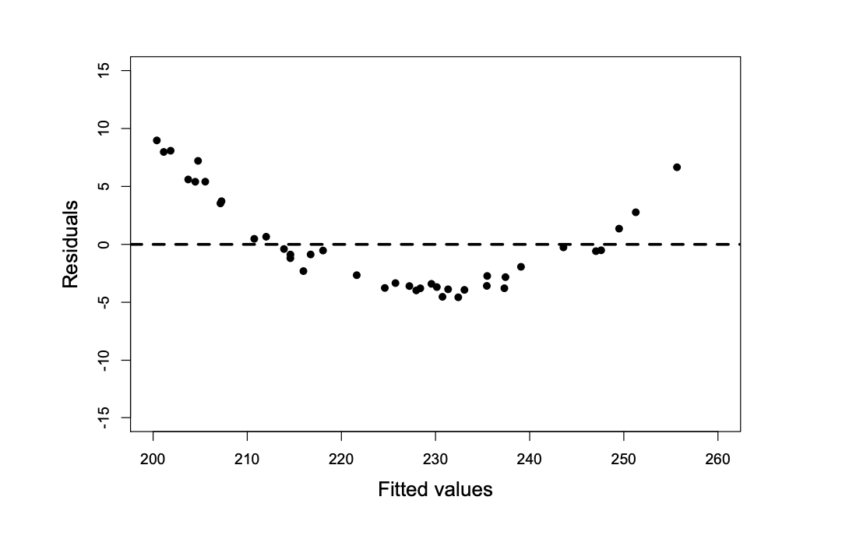
Assumptions: linearity
Other predictors
Transformation of response
Transformation of features

Slide 37
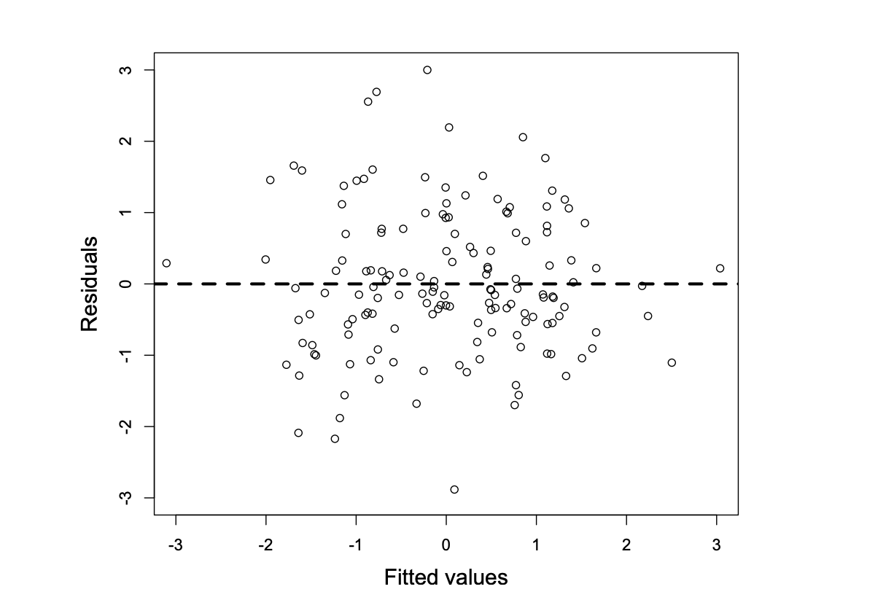
Assumptions
Homoskedasticity
the variability of your data should be approximately equal across the range of your predicted values

Slide 38
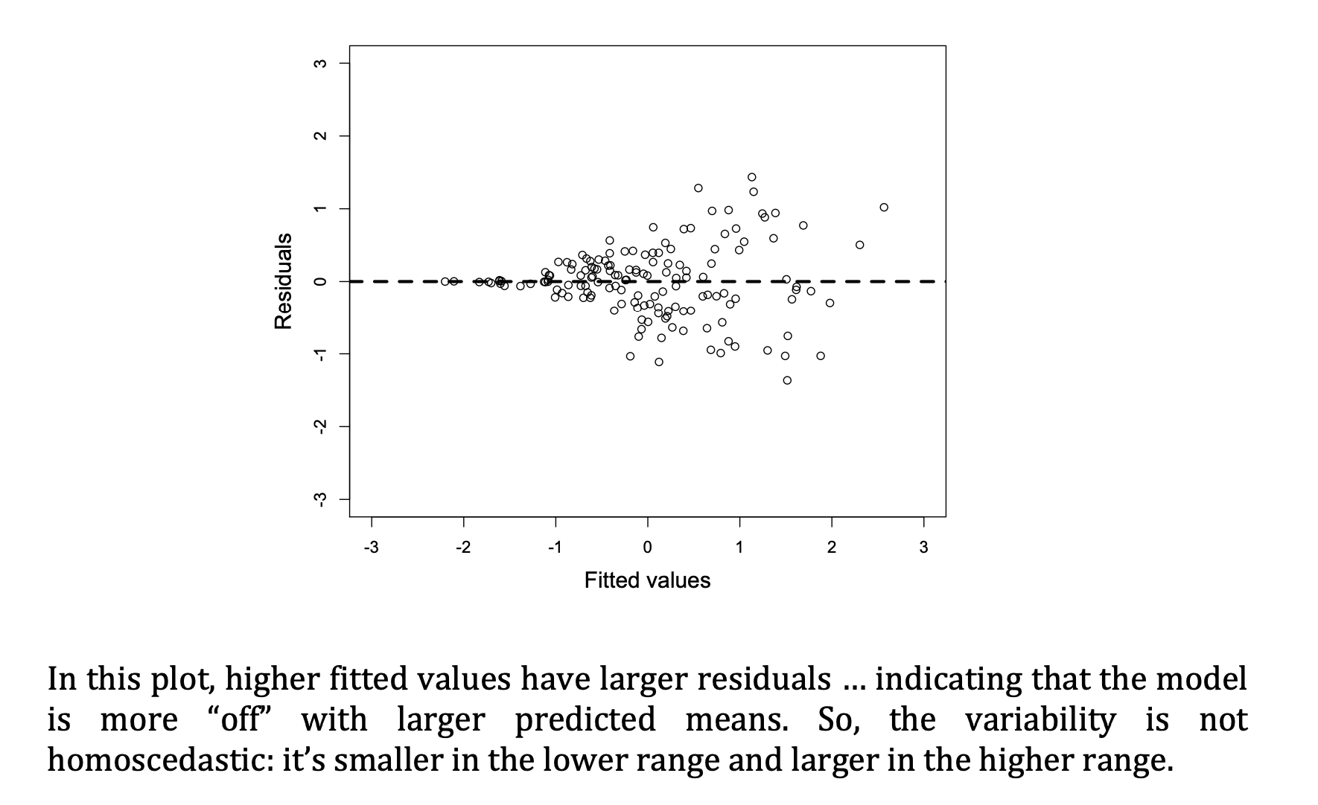
Assumptions
Homoskedasticity
WHAT TO DO? TRANSFORM YOUR DATA

Slide 39
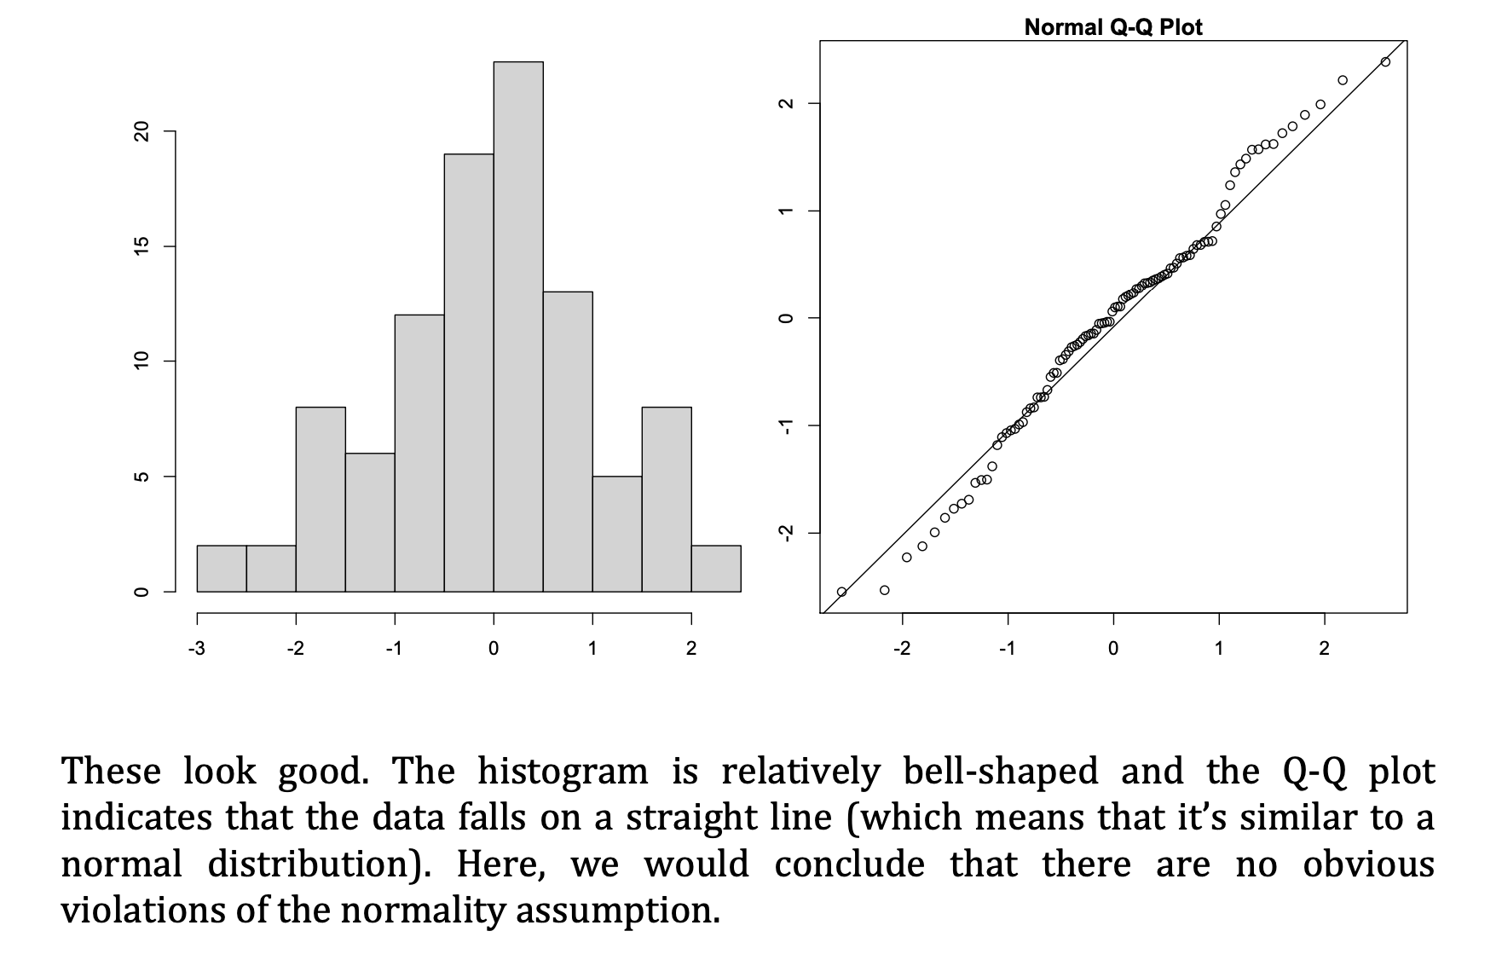
Assumptions
NORMALITY OF RESIDUALS
Q-Q plot
https://stackoverflow.com/questions/13865596/quantile-quantile-plot-using-scipy

Slide 40
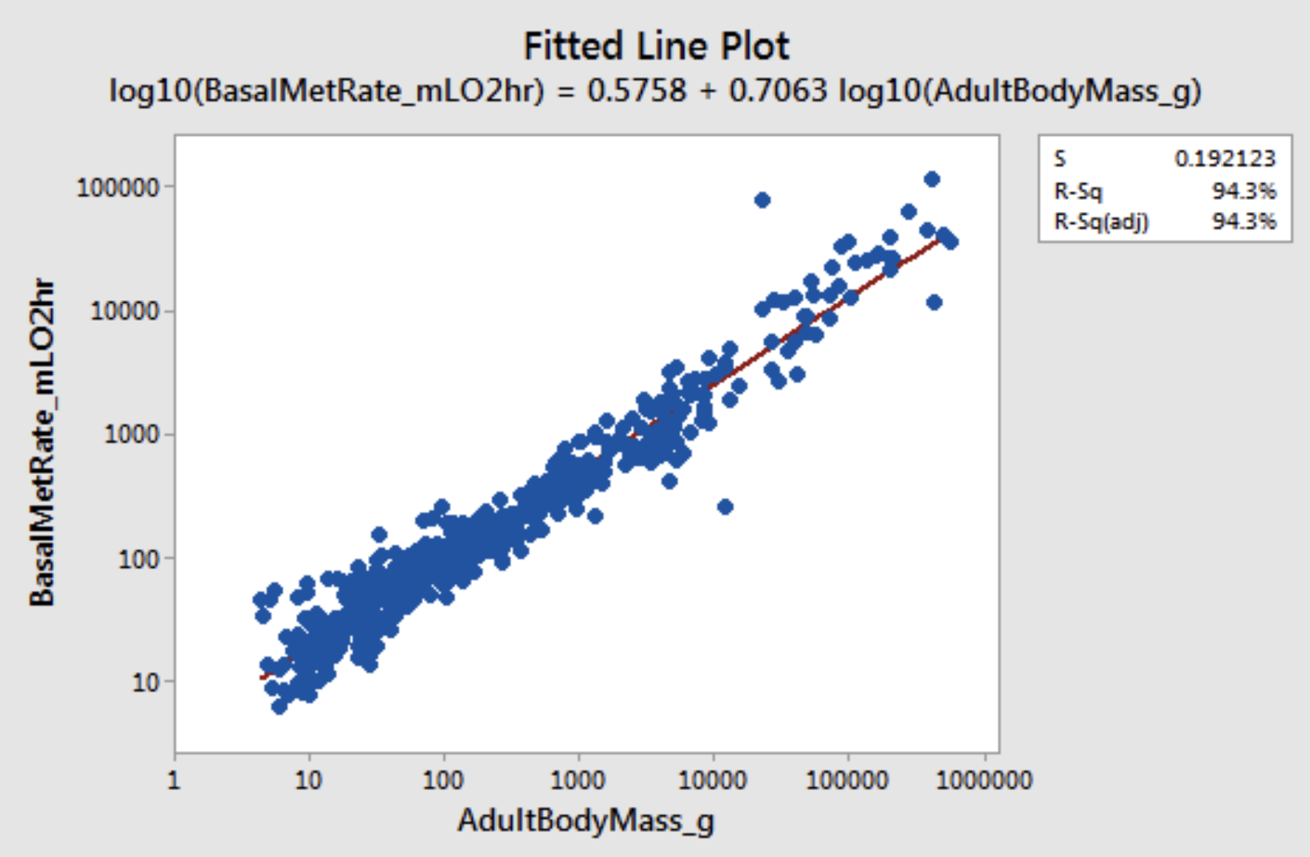
Data transformations
Log-log plots
Check these for normality. For example, if the distribution is not normal, then maybe you can transform the data somehow.
https://statisticsbyjim.com/regression/log-log-plots/
Notes:
https://statisticsbyjim.com/regression/log-log-plots/

Slide 41
autocorrelations
Notes:
https://statisticsbyjim.com/regression/log-log-plots/

Slide 42
Shiny apps for rapid prototyping and communication
Notes:
Example of IL10 project (tSNE and heatmaps from a bioinformatics project)

Slide 43
material
Material, code, exercises, activities
https://github.com/neelsoumya/visualization_lecture
Derivations and technical details
https://github.com/neelsoumya/visualization_lecture/blob/main/mathematics_data_science.pdf

